Slide 1
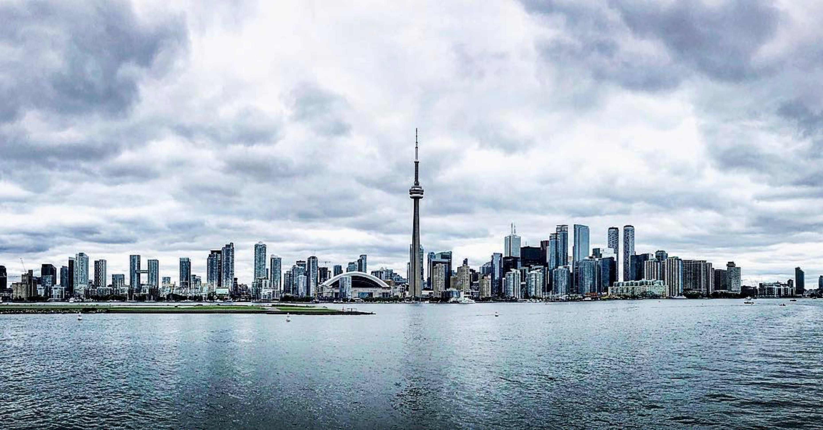
Toronto’s Top Neighborhood
Presenter: Wei Yi
Date: June 20, 2020
For: Coursera Capstone Project

Slide 2
Table of Content
1. Introduction
2. Data Acquisition and Cleaning
3. Methodology: Exploratory Data Analysis
4. Conlusion

Slide 3
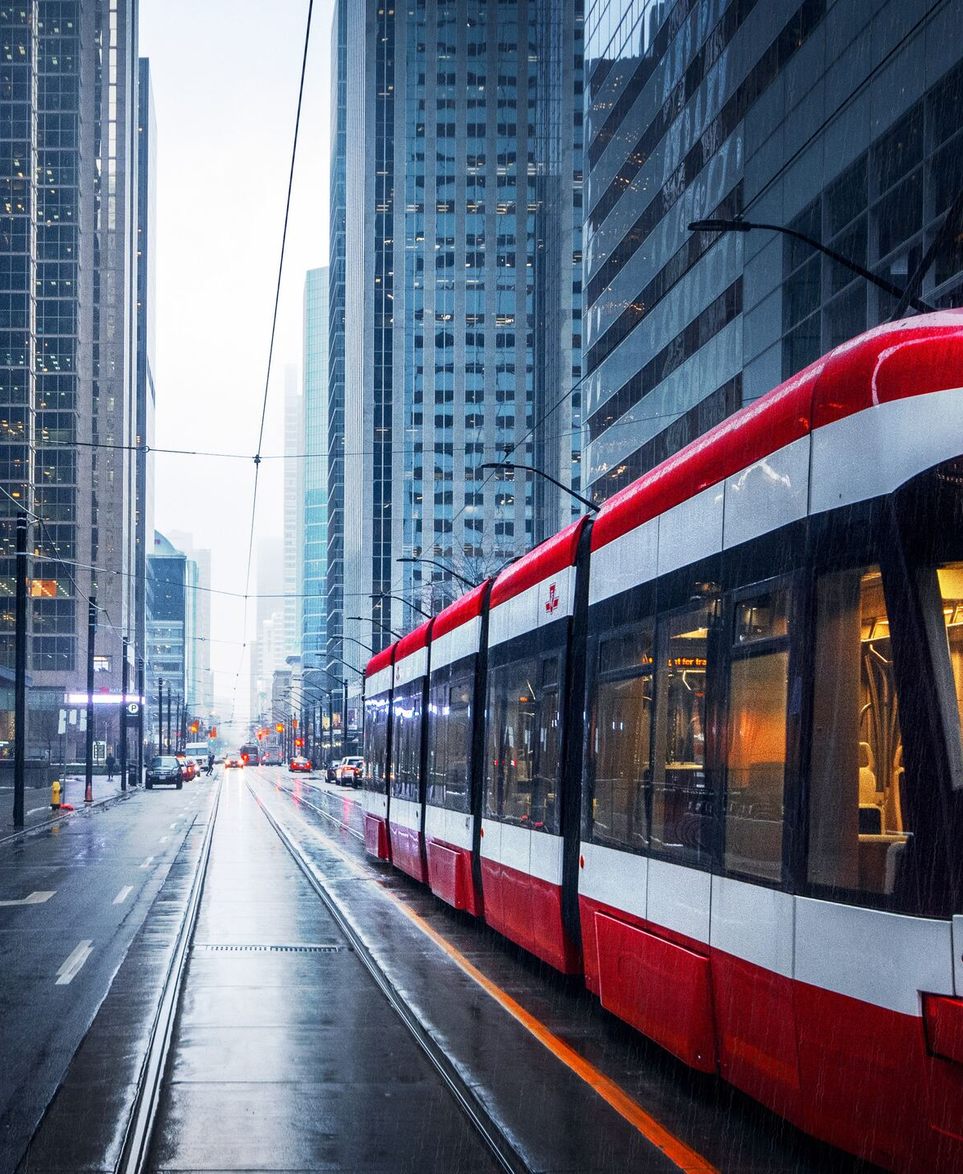
1. Introduction
1.1 Background
The Greater Toronto Area (GTA) is the most populous metropolitan area in Canada. It consists of the City of Toronto and 4 surrounding regional municipalities: Durham, Halton, Peel, and York. There are 25 incorporated municipalities in the GTA area, and is recognized as one of the most multicultural and cosmopolitan cities in the world. The metropolitan area continues to grow and attract immigrants from all over the world
1.2 Problem
For new immigrants and families interested in Toronto as a place to live, and would like to find cultural/entertainment opportunities and establishments (restaurants, museums, parks, etc.) best suited for their own needs, this analysis will attempt to find things to do for new comers in Toronto that have a relatively high number of venues.
1.3 Interest
The key audience for this research is new immigrants who are considering a move to Toronto. Personally, I’m also interested in this analysis. Having lived in GTA for almost 6 years, I am looking forward to applying data science methods and location data to gain a better understanding of the key neighborhoods in the Toronto.

Slide 4
2. Data Acquisition and Cleaning
List of neighorhood: Berczy Park
Brockton, Parkdale Village, Exhibition Place
Business reply mail Processing Centre, South Central Letter Processing Plant Toronto
CN Tower, King and Spadina, Railway Lands, Harbourfront West, Bathurst Quay, South Niagara, Island airport
Central Bay Street
Christie
Church and Wellesley
Commerce Court, Victoria Hotel
Davisville
Davisville North
Dufferin, Dovercourt Village
First Canadian Place, Underground city
Forest Hill North & West, Forest Hill Road Park
Garden District, Ryerson
Harbourfront East, Union Station, Toronto Islands
High Park, The Junction South
India Bazaar, The Beaches West
Kensington Market, Chinatown, Grange Park
Lawrence Park
Little Portugal, Trinity
Moore Park, Summerhill East
North Toronto West, Lawrence Park
Parkdale, Roncesvalles
Queen's Park, Ontario Provincial Government
Regent Park, Harbourfront
Richmond, Adelaide, King
Rosedale
Roselawn
Runnymede, Swansea
St. James Town
St. James Town, Cabbagetown
Stn A PO Boxes
Studio District
Summerhill West, Rathnelly, South Hill, Forest Hill SE, Deer Park
The Annex, North Midtown, Yorkville
The Beaches
The Danforth West, Riverdale
Toronto Dominion Centre, Design Exchange
University of Toronto, Harbord
2.1 Data Sources
Canada Post provides a free postal code look-up tool on its website, and for this analysis, we will be using data from this Wikipedia page:https://en.wikipedia.org/wiki List_of_postal_codes_of_Canada:M (https://en.wikipedia.org/wiki/List_of_postal_codes_of_Canada:M) As for geographical coordinates of the neighborhoods, we will be using this link to a csv file: http://cocl.us/Geospatial_data
(http://cocl.us/Geospatial_data).
For each neighborhood, I use the following types off data (source in parenthesis):
Latitude (Foursquare API)
Longitude (Foursquare API)
Venues (Foursquare API)
Type of Venue (Foursquare API)
Postal code (Wikipedia)

Slide 5
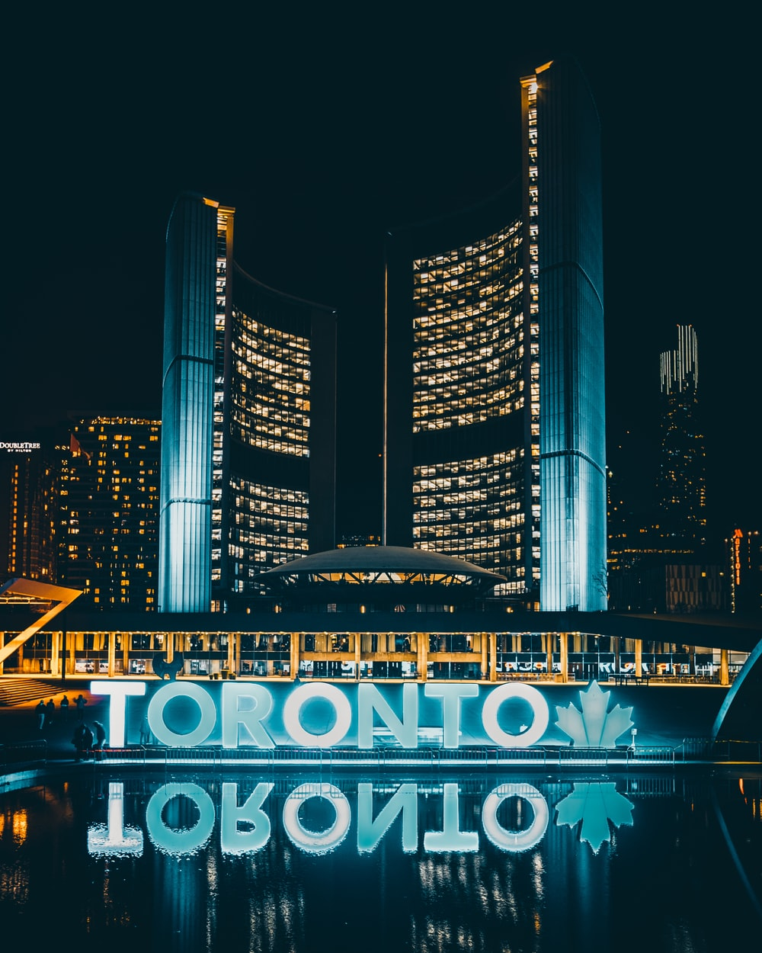
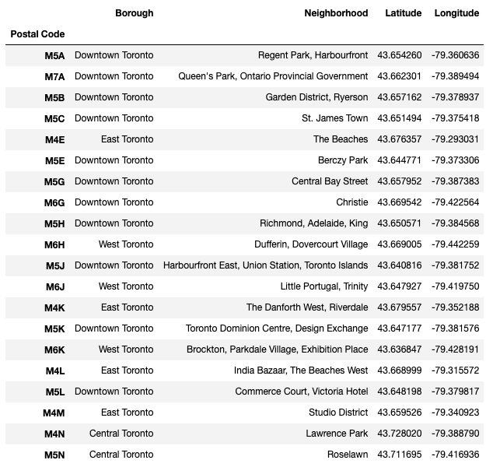
2.2 Data Cleaning
Data for this analysis was pulled from listed sources, and compiled into one table. The data scraping and wrangling process using Pandas/Python was used to access neighborhood and venue data from the Foursquare API. All data are very recnet, from 2020. Please find the table below for your review:

Slide 6
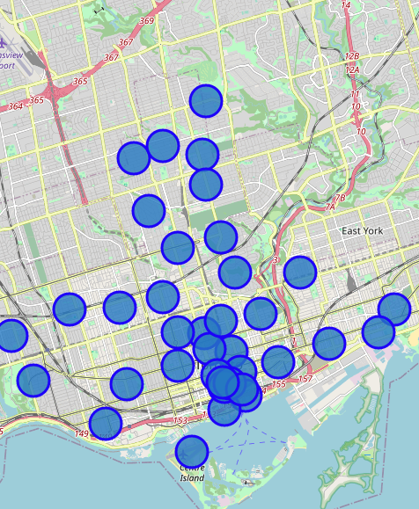
3. Methodology
3.1 Built dataframe of the postal code, latitude and the longitude coordinates of each neighborhood
3.2 Segmenting and clustering neighborhood in Toronto

Slide 7
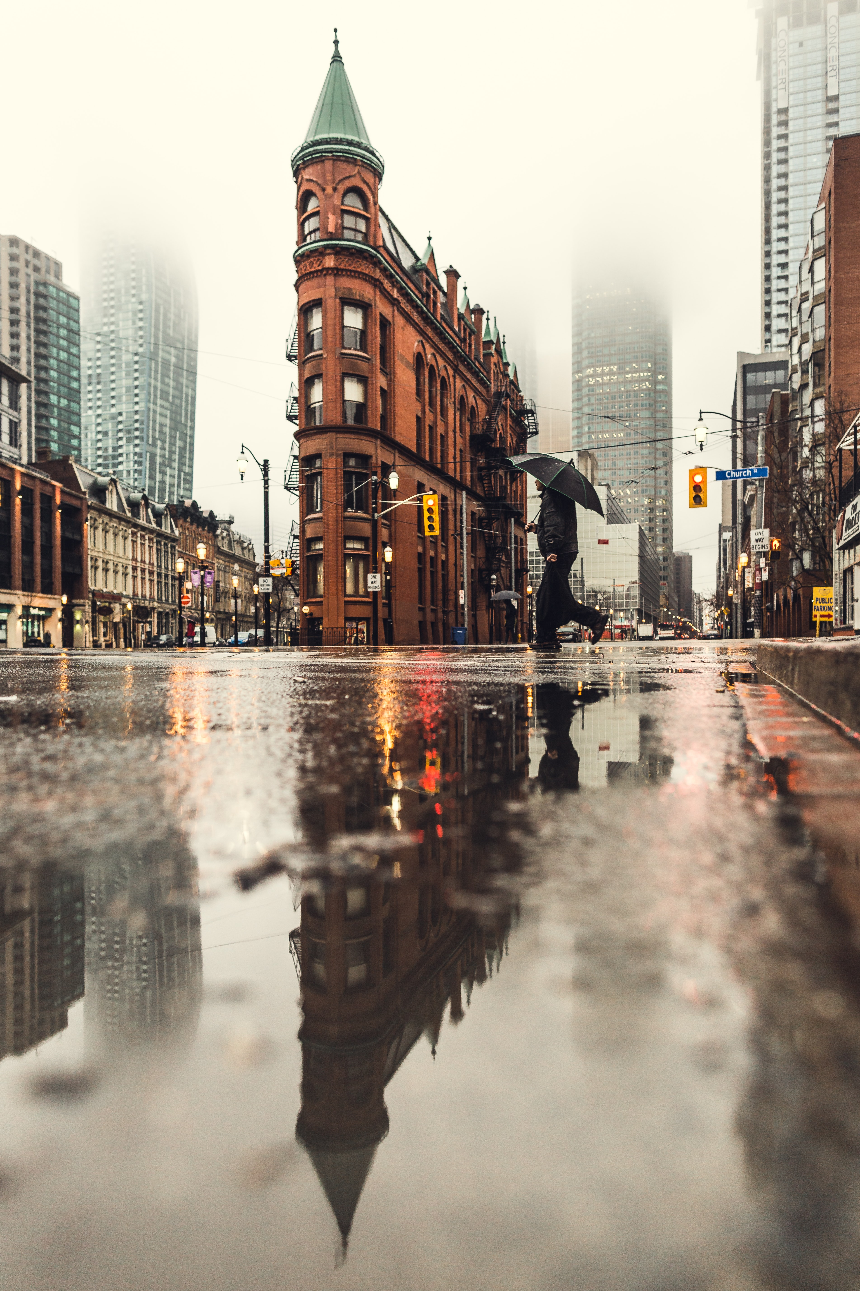
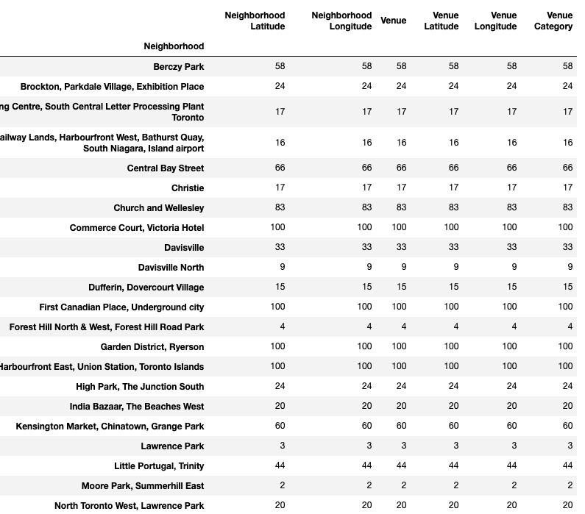
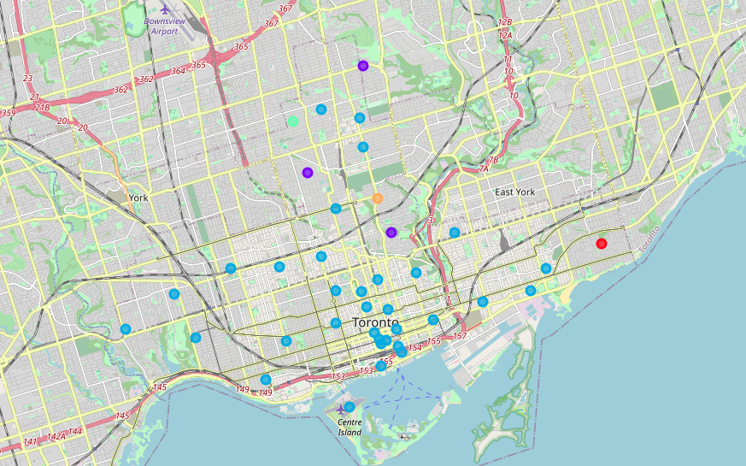

Slide 8
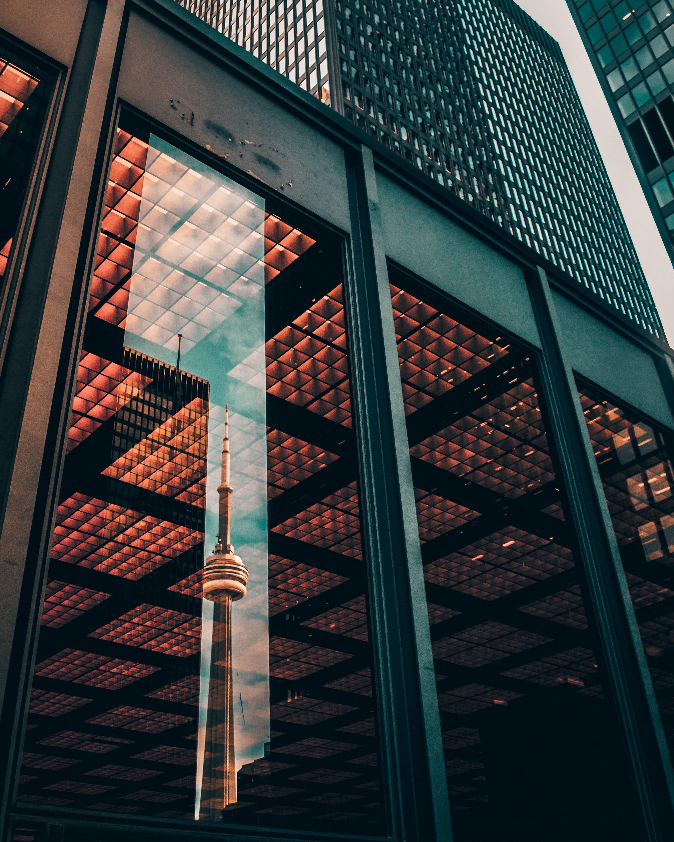
4. Conlusion
4.1 Top 10 most popular neighborhood:
Harbourfront, Regent Park
Queen's park
Garden District, Ryerson
St. James Town
The Beaches
Berczy Park
Central Bay Street
Christie
Richmond, Adelaide, King
Dufferin, Dovercourt Village

Slide 9

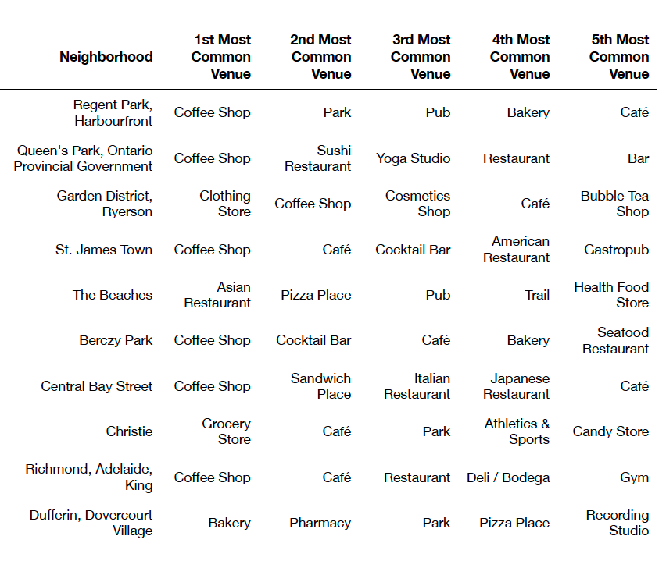
4.2 Most popular venues in each top neighborhood

Slide 10
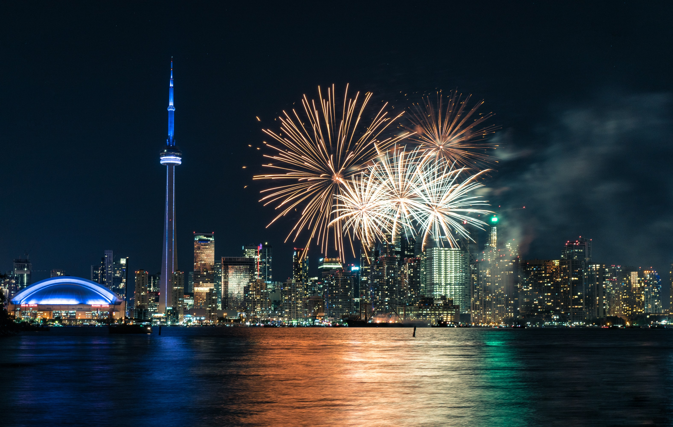
Thank You

